Slide 1
YOLO V5:
A Novel Approach In Ensuring Safety Among Road Users
2nd International Conference on Advancements in Smart, Secure and Intelligent Computing (ASSIC 2024)
SACHIDANANDA TRIPATHY Designation (Student)
B.Tech Computer Science & Information Technology
Institute Of Technical Education & Research Siksha 'O' Anusandhan Deemed to be University
Bhubaneswar ,Odisha ,India

Slide 2
Outline
Introduction
Existing Approaches/Related Works
Problems in Existing Approaches
Proposed Methodology
Results and Discussion
Conclusions and Future Work
References

Slide 3
Introduction
YOLO v5 (You Only Look Once Version 5) is an upgraded version of YOLO v4 and v3.
Known for its superior speed, efficiency, and enhanced object detection capabilities through deep neural networks.
YOLO v5 introduces various models catering to diverse needs: YOLO v5n, YOLO v5s, YOLO v5m, YOLO v5l, and YOLO v5x.
Helmet monitoring models play a important role in safety assessment, particularly in high-risk industries like building sites and roads.
Redmon et al. introduced the YOLO (You Only Look Once) technique in 2015, revolutionizing object detection with its superior speed.
YOLOv3, released in 2018 & YOLOv5 in 2020.
YOLOv5 excels in identifying small objects, crucial for helmet detection.
Helmet monitoring models find extensive application in various industries with multiple users, ensuring safety and compliance.
The evolution from YOLO to YOLOv5 reflects the ongoing improvement in object detection techniques.
The research spans 200 iterations (epochs) to comprehensively assess model performance.

Slide 4
Existing Approaches/Related Works
Helmet Detection:
Detect and identify helmets in images using deep learning.
Employ Convolutional Neural Networks (CNNs) for helmet detection.
Utilize labeled images of helmets to train the CNN.
Training Process:
CNN learns unique patterns and features of helmets during training.
Identifies specific characteristics for each helmet type.
The CNN-based approach proves effective for reliable helmet detection.
Evolution of YOLO:
Real-time object detection in images and videos.
Analyzes entire images in milliseconds.
Single neural network produces bounding boxes and class probabilities.
Training: Large database with labeled images and bounding boxes.
YOLO identifies objects within bounding boxes.
Quick and simple compared to other techniques.
Achieves high fidelity with a limited number of parameters.

Slide 5
Problems in Existing Approaches
Ensure that all libraries (cv2, Torch, Numpy) are at versions compatible with YOLOv5.
YOLOv5 may have additional dependencies; make sure all required packages are installed.
Refer to YOLOv5 documentation and the documentation of each library for proper usage.

Slide 6
Proposed Methodology
Three key libraries are integral to our code:
CV2
TORCH
NUMPY AS NP
CV2 : Image processing tasks.
TORCH (PyTorch) : Essential for building and training neural networks.
NUMPY AS NP: Allowing for concise and commonly used array and numerical operations .
START
IMAGE OR VIDEO
PRE PROCESS
TRAIN MODEL
DETECTION

Slide 7
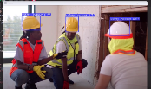
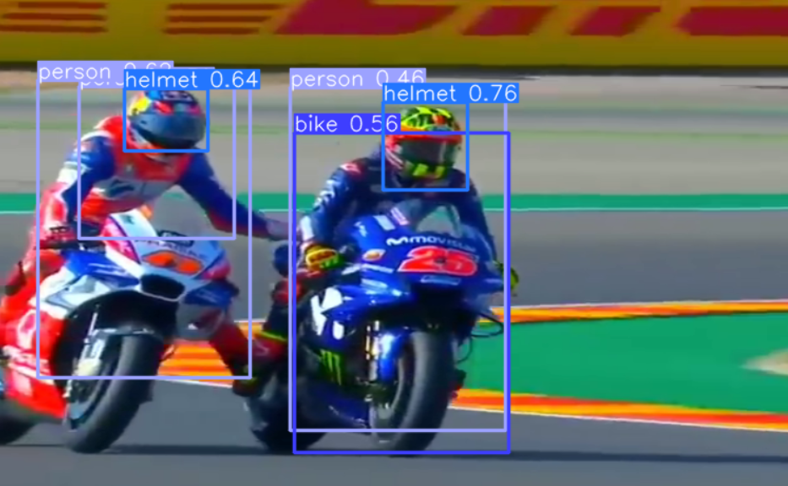
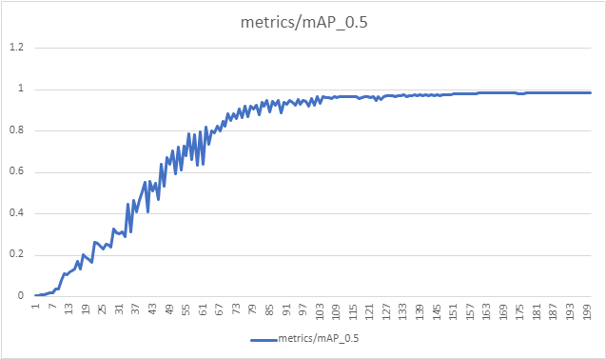
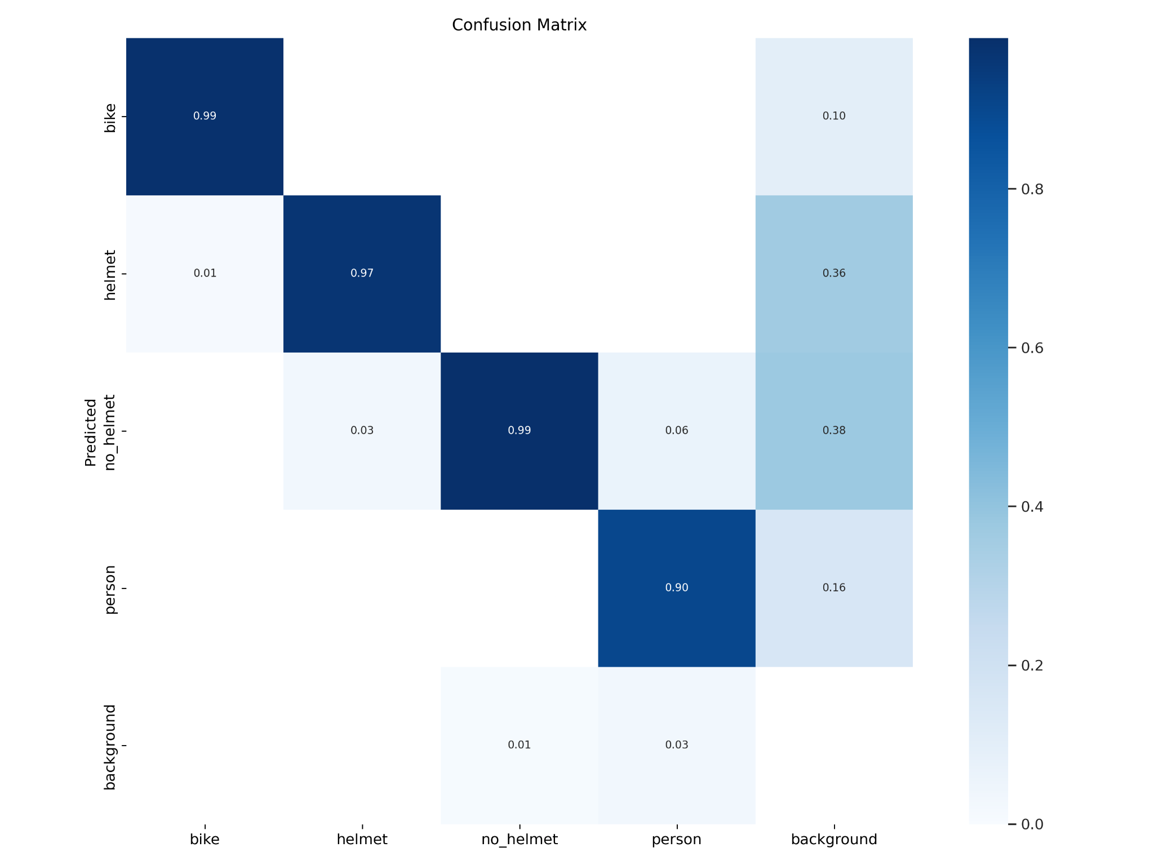
Results and Discussion
We observed that the accuracy in every epoch is changing rapidly.
The detected helmet can be seen in Fig. along with the bounding boxes for each class ,after running the code in Thonny python platform.
5 classes
Bike
Helmet
No_helmet
Person
background

Slide 8
Conclusions and Future Work
According to the data shown above, it is clear that YOLOv5 object detection is well suited for real-time processing and was successful in correctly classifying and localizing all object types.
YOLOv5 is great at quickly finding and recognizing different things in real-time.
It can tell what things are and where they are located accurately.
The primary goal of the project was to address the issue of ineffective traffic management.
Now we are working on it to improve this model .

Slide 9
References
Nathan BAi, “Countries With The Highest Moterbike Usage” Moter riders in Bangkok
Freedomwebtech,https://github.com/freedomwebtech/yolov5train
https://www.freepik.com/premium-photo/professional-mechanical-engineer-team-working-construction-site_13641616.htm
https://pytorch.org/hub/ultralytics_yolov5/
Alexey Bochkovskiy, Chien-Yao Wang, and HongYuan Mark Liao. Yolov4: Optimal speed and accuracy of object detection. arXiv preprint arXiv:2004.10934, 2020.
Kaiming He, Xiangyu Zhang, Shaoqing Ren, and Jian Sun. Deep residual learning for image recognition. In CVPR, vol. 1, 2016.
Qiang Chen, Yingming Wang, Tong Yang, Xiangyu Zhang, Jian Cheng, and Jian Sun. You only look one-level feature. In CVPR, 2021
Joseph Redmon and Ali Farhadi. Yolo9000: Better, faster, stronger. In CVPR, 2017.
https://www.worldatlas.com/articles/countries-that-ride-motorbikes.html
A. Krizhevsky, I. Sutskever, G. E. Hinton, “Imagenet classification with deep convolutional neural networks”, Communications of the ACM, vol. 60, no. 6, pp. 84-90, 2017.
10. S. M. Abbas and S. N Singh, “Region-based object detection and classification using
faster R-CNN”, 4th International Conference on Computational Intelligence &
Communication Technology (CICT), IEEE, pp. 1-6, 2018. 11. C. Kwan, et al., “Real-time and deep learningbased vehicle detection and classification
using pixel-wise code exposure measurements”, Electronics, vol. 9, no. 6, pp. 10-14,
2020. 12. V. Bamane, J. Sapkale, A. Pawar, P. G. Chilveri, N. Akhter, N., A. A. B. Raj, “A
Review on AI Based Target Classification Advanced Techniques”, vol. 10, no. 4, pp
. 88-99, 2022. 13. R. Pérez, et al., “Deep-learning radar object detection and classification for urban
automotive scenarios”, Kleinheubach Conference, IEEE, pp. 1-4, 2019.
14. T. Chen, et al., “Road marking detection and classification using machine learning
algorithms”, IEEE Intelligent Vehicles Symposium (IV) , IEEE, pp. 617-621, 2015.
15 J. Redmon, et al., “You only look once: Unified, real-time object detection”, In:
Proceedings of the IEEE conference on computer vision and pattern recognition,
pp. 779-788, 2016.

